Slide 1


Parallel Construction of Independent Spanning Trees
This presentation delves into the parallel construction of Independent Spanning Trees (ISTs) within Bubble-Sort Networks. It's based on the research paper "A Parallel Algorithm for Constructing Multiple Independent Spanning Trees in Bubble-Sort Networks" by Shih-Shun Kao, Ralf Klasing, Ling-Ju Hung, Chia-Wei Lee, and Sun-Yuan Hsieh. This work is part of the Parallel and Distributed Computing course and explores how to optimize network resilience.
by bilal naveed

Slide 2
Problem Motivation
Secure Communication
Fault Tolerance
Bubble-Sort Networks
Ensuring data broadcasts are secure is paramount in modern networks. Protecting against eavesdropping and tampering requires robust communication strategies that can handle potential vulnerabilities.
Networks must withstand failures and maintain functionality despite disruptions. Implementing redundancy through independent spanning trees can significantly enhance a network's resilience.
Bubble-sort networks have unique structural properties that make them ideal for IST construction. Understanding these properties is key to optimizing their resilience and efficiency in parallel computing.

Slide 3

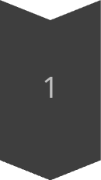
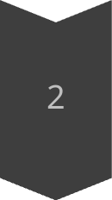
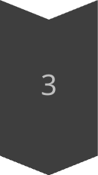
Bubble-Sort Networks Overview
Definition
Bubble-sort networks are \( n \)-dimensional networks arranged based on the principles of bubble-sort algorithms. The structure facilitates specific computational and routing capabilities.
Vertices and Edges
In a bubble-sort network with \( n = 3 \), there is a distinct arrangement of vertices and edges. This setup influences data flow and network characteristics, such as connectivity.
Network Size
A bubble-sort network contains \( n! \) vertices, which determines the network's capacity. The connectivity properties are advantageous for parallel computing and secure data transmission.

Slide 4

Independent Spanning Trees (ISTs)
Definition
Importance
ISTs are rooted at a single vertex and extend to all other vertices via disjoint paths. This unique property ensures that no single point of failure disrupts communication between vertices.
ISTs guarantee network robustness by maintaining multiple communication paths. They also enhance parallel communication efficiency by providing alternative routes for data transmission.
Existing Problems
Recursive algorithms often used in IST construction introduce inefficiencies in parallel execution. Overcoming this limitation is crucial for optimizing parallel computation.

Slide 5


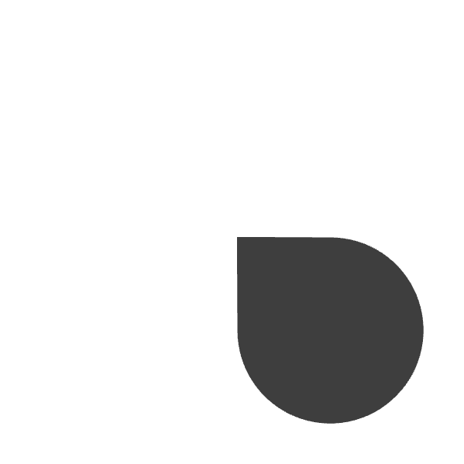
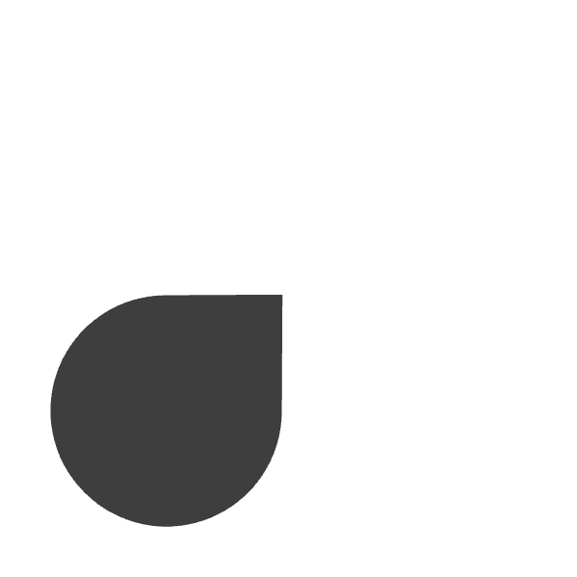
Parallel Algorithm Design
Parallelized
Non-Recursive
The algorithm is fully parallelized, allowing simultaneous path determination at each vertex. This dramatically reduces computational time and improves overall performance.
Our algorithm constructs ISTs without recursion, significantly boosting efficiency in parallel execution. This contrasts with traditional recursive approaches.
1
2
Vertex Labeling
Constant-Time
4
3
We use vertex labeling and local computations to streamline IST construction. This simplifies the process and enhances adaptability in different network configurations.
Parent determination at each vertex is achieved in constant time, optimizing computational overhead. This ensures fast and reliable pathfinding throughout the network.

Slide 6
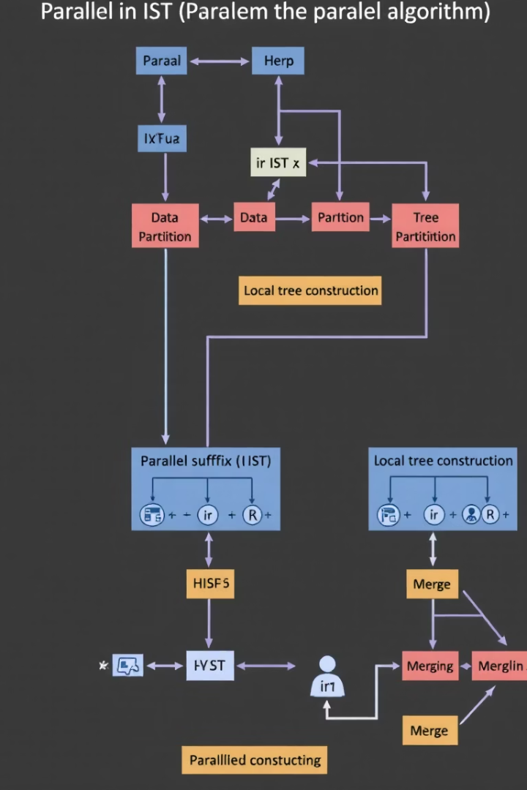
Algorithm Details
Input
Our algorithm accepts a bubble-sort network with \( n! \) vertices as its primary input. This forms the basis for constructing multiple independent spanning trees.
Step-by-Step Construction
The construction process involves root assignment followed by precise path determination. These steps are critical for achieving fully disjointed paths within the network.
Visual Example
For a network with \( n = 4 \), we illustrate the tree formation process visually. This demonstrates how vertices connect to form independent trees that enhance reliability.

Slide 7
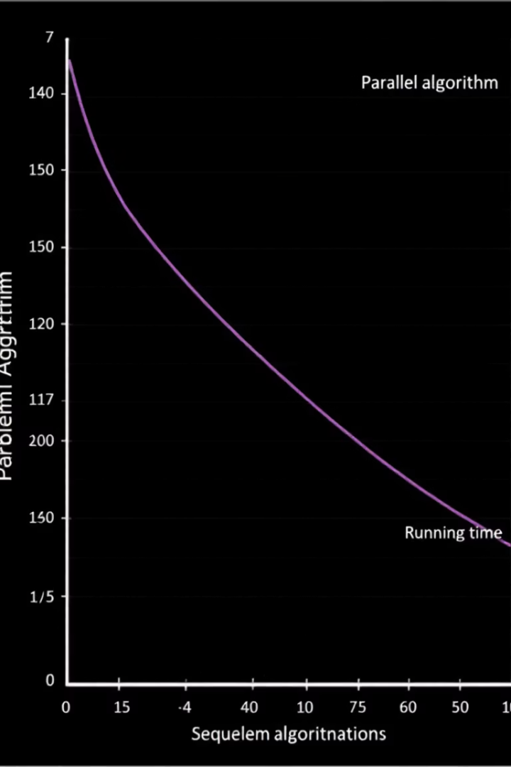



Time Complexity
Optimal Time
Scalability
Comparison
Our algorithm achieves asymptotically optimal computational time of \( O(\log n) \). This signifies its capability to efficiently construct ISTs in large networks.
The algorithm maintains high performance as the network size \( n \) grows. This scalability ensures its suitability for expanding parallel computing environments.
Our approach delivers notable benefits over recursive methods, reducing delays and optimizing parallel execution. This highlights its practical advantages in IST construction.

Slide 8



Fault Tolerance Evaluation
Failure Scenarios
Our analysis demonstrates fault-resilient properties under various failure scenarios. This includes the ability to maintain communication despite edge or vertex faults.
1
Edge/Vertex Faults
2
We specifically analyze bubble-sort networks with edge or vertex faults to ensure uninterrupted communication. This guarantees continuous network functionality.
Uninterrupted Communication
3
Our fault tolerance evaluation confirms the resilience of our method, ensuring reliable communication even when the network faces unexpected failures or disruptions.

Slide 9

Applications
99.99%
5X
Network Uptime
Performance Increase
100%
Secure Delivery
Our method is highly suitable for secure message distribution in parallel computing environments, where data protection is critical. Its robustness makes it ideal for distributed systems requiring enhanced reliability. The concepts can be adapted to network topologies with similar characteristics, extending the scope of applications.

Slide 10
Conclusion
Efficient Construction
1
We have presented an efficient and parallelized IST construction method. This offers a streamlined approach for enhancing network reliability and scalability.
Broader Implications
2
Our contributions have significant implications for improving network resilience and scalability. They also open possibilities for new research directions and advancements.
Future Work
Future work involves extending our methods to other network architectures, further broadening the applications and impact of this research in the field of distributed computing.
3

